Slide 1
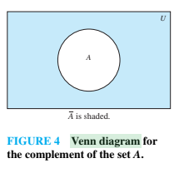
Complement
Definition: If A is a set, then the complement of the A (with respect to U), denoted by Ā is the set U - A
Ā = {x ∈ U | x ∉ A}
(The complement of A is sometimes denoted by A^{c} .)
Example: If U is the positive integers less than 100, what is the complement of {x | x > 70}
Solution: {x | x ≤ 70}
Venn Diagram for Complement
Ā

Slide 2
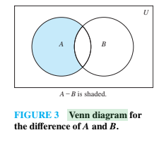
Difference
Definition: Let A and B be sets. The difference of A and B, denoted by A – B, is the set containing the elements of A that are not in B. The difference of A and B is also called the complement of B with respect to A.
A – B = {x | x ∈ A ∧ x ∉ B} = A ∩‾B
U ={1,2,3,..,10}
A = {1,2,3}
B = {4,5,6}
Check whether A-B = A intersection B’
Venn Diagram for A − B

Slide 3
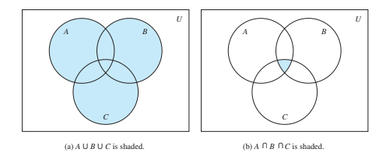

Slide 4
The Cardinality of the Union of Two Sets
Law of Inclusion-Exclusion
|A ∪ B| = |A| + | B| - |A ∩ B|
A= 10,Physics
B = 15, CS Majors
A intersection B = C = Math and both CS , 5
10+15-5 = 20
Total students = 600-20= 580
Example: Let A be the math majors in your class and B be the CS majors. To count the number of students who are either math majors or CS majors, add the number of math majors and the number of CS majors, and subtract the number of joint CS/math majors.
We will return to this principle in Chapter 6 and Chapter 8 where we will derive a formula for the cardinality of the union of n sets, where n is a positive integer.
U
A
B
Venn Diagram for A, B, A ∩ B, A ∪ B

Slide 5
Review Questions
Example: U = {0,1,2,3,4,5,6,7,8,9,10} A = {1,2,3,4,5}, B ={4,5,6,7,8}
A ∪ B
Solution: {1,2,3,4,5,6,7,8}
A ∩ B
Solution: {4,5}
Ā
Solution: {0,6,7,8,9,10}
Solution: {0,1,2,3,9,10}
A – B
Solution: {1,2,3}
B – A
Solution: {6,7,8}

Slide 6


Symmetric Difference (optional)
Definition: The symmetric difference of A and B, denoted by is the set
Example:
U = {0,1,2,3,4,5,6,7,8,9,10}
A = {1,2,3,4,5} B ={4,5,6,7,8}
A- B = 1,2,3
B-A = 6, 7,8
What is:
Solution: {1,2,3,6,7,8}
U
A
B
Venn Diagram

Slide 7



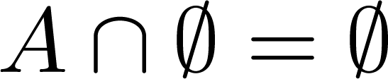


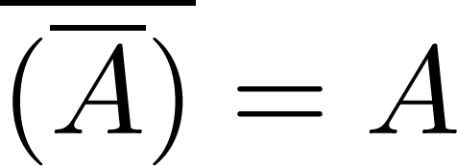
Set Identities
Identity laws
Domination laws
Idempotent laws
Complementation law
Continued on next slide →

Slide 8


Set Identities
Commutative laws
Associative laws
Distributive laws
Continued on next slide →

Slide 9





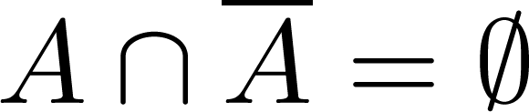
Set Identities
De Morgan’s laws
Absorption laws
Complement laws

Slide 10
Proving Set Identities
Different ways to prove set identities:
Prove that each set (side of the identity) is a subset of the other.
Use set builder notation and propositional logic.
Membership Tables: Verify that elements in the same combination of sets always either belong or do not belong to the same side of the identity. Use 1 to indicate it is in the set and a 0 to indicate that it is not.

Slide 11


Proof of Second De Morgan Law
Example: Prove that
Solution: We prove this identity by showing that:
1) and
2)
Continued on next slide →

Slide 12
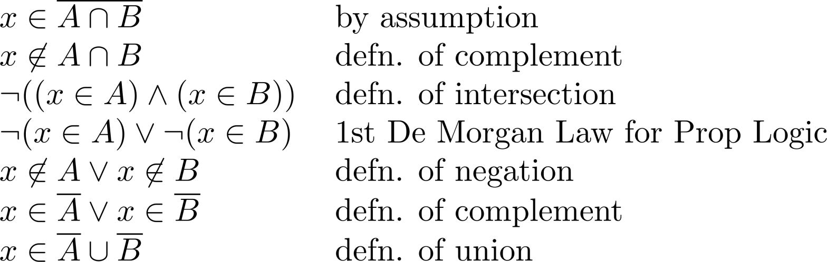
Proof of Second De Morgan Law
These steps show that:
Continued on next slide →

Slide 13
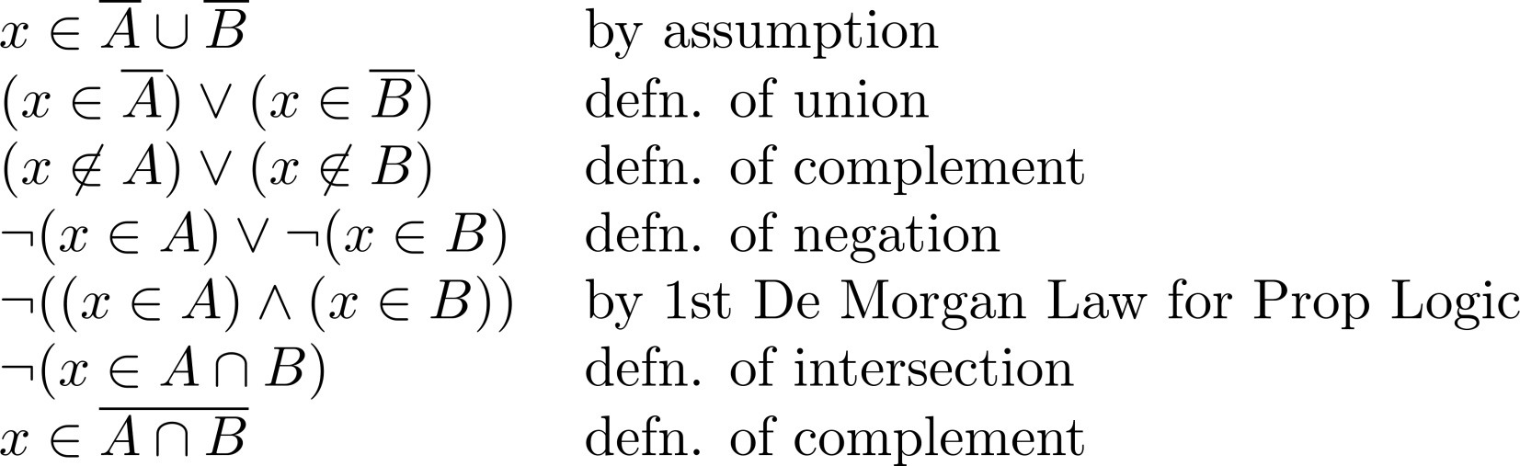
Proof of Second De Morgan Law
These steps show that:

Slide 14
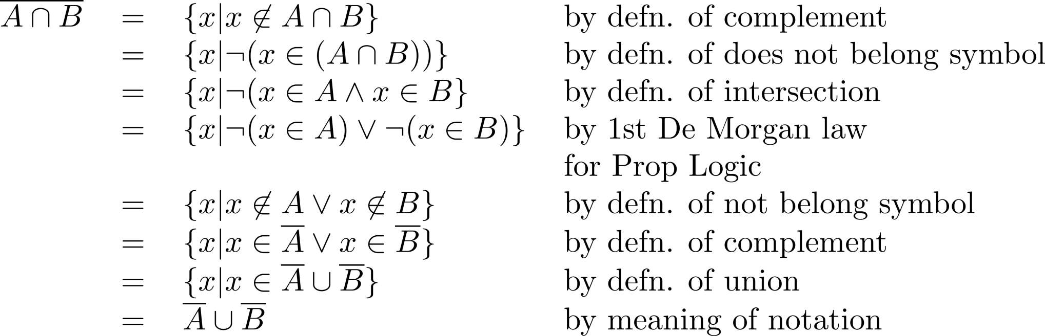
Set-Builder Notation: Second De Morgan Law

Slide 15





Membership Table
Example:
Construct a membership table to show that the distributive law holds.
Solution:
A | B | C
1 | 1 | 1 | 1 | 1 | 1 | 1 | 1
1 | 1 | 0 | 0 | 1 | 1 | 1 | 1
1 | 0 | 1 | 0 | 1 | 1 | 1 | 1
1 | 0 | 0 | 0 | 1 | 1 | 1 | 1
0 | 1 | 1 | 1 | 1 | 1 | 1 | 1
0 | 1 | 0 | 0 | 0 | 1 | 0 | 0
0 | 0 | 1 | 0 | 0 | 0 | 1 | 0
0 | 0 | 0 | 0 | 0 | 0 | 0 | 0

Slide 16

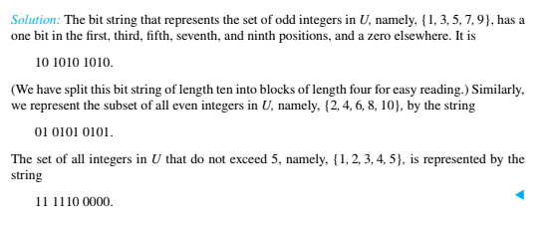
Computer Representation of Sets

Slide 17

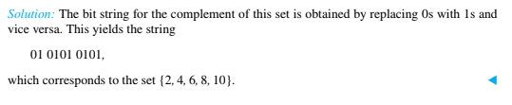
Problem

Slide 18

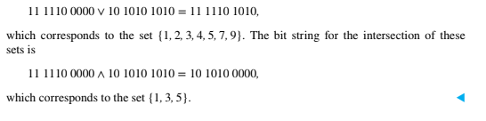
Problem

